Slide 1

Amazon Stock Price Analysis and Prediction using Machine Learning
April 2023

Slide 2

Objective and Significance
The scope of this project is to build several deep learning algorithms based on RNN techniques that can predict future values of an indicator using Time-Series Forecasting methods in order to achieve the highest possible accuracy
Stock market prediction is the act of trying to determine the future value of company stock or other financial instruments traded on an exchange. The successful prediction of a stock’s future price could yield significant profit.

Slide 3
Data Source and Description
Data source: Amazon Stock Data | Kaggle
Open = Price from the first transaction of a trading day
High = Maximum price in a trading day
Low = Minimum price in a trading day
Close = Price from the last transaction of a trading day
Adj Close = Closing price adjusted to reflect the value after accounting for any corporate actions
Volume = Number of units traded in a day

Slide 4
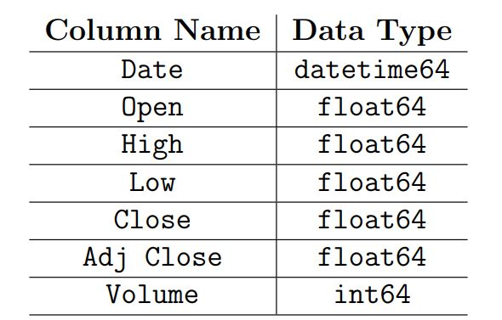
Wrangling
The purpose of data wrangling and cleaning are:
• To ensure that all features are of the correct data type.
• To ensure that missing values are properly dealt with (imputation).
• To prepare the data set for exploratory data analysis and statistical analysis

Slide 5

Incorrect Values & Imputation
No missing values in the dataset.
Most of the features were the correct data type.
Only change need was the date feature to a datetime64 object and set it to our index. This was done so we can work with it as a time series.

Slide 6
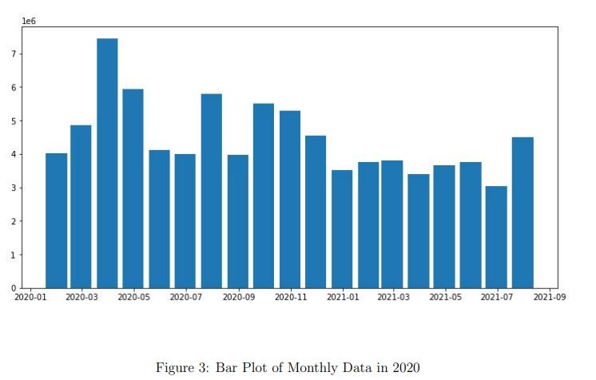
Seasonality

Slide 7
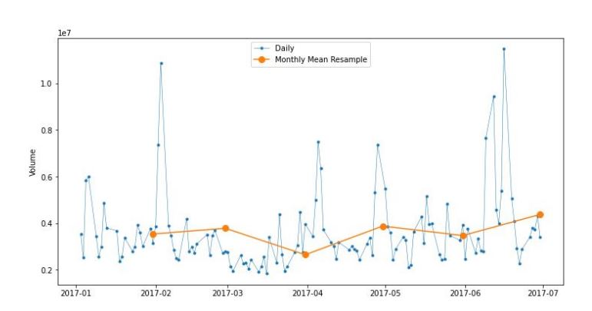
Resampling and Rolling

Slide 8
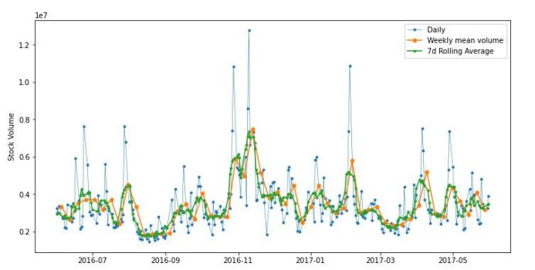
Rolling

Slide 9

Data Modeling
We elected to use Recurrent Neural Networks (RNNs) for modeling sequential data and a specific subset of sequential data—time-series data.

Slide 10
RNNs and Sequential Data
What makes sequences unique, is that elements in a sequence appear in a certain order and are not independent of each other.
typical machine learning algorithms for supervised learning assume that the input data is IID.
This assumption is not valid anymore when we deal with sequences-by definition, order matters

Slide 11
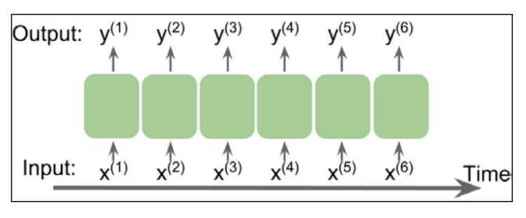
Representing Sequences

Slide 12
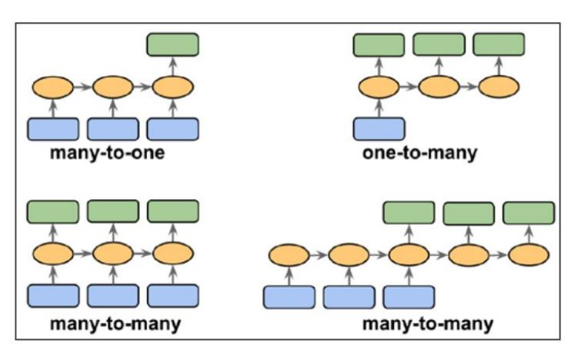
Different Categories of Sequential Modeling

Slide 13
Challenges and Solutions
Backpropagation through time will cause the vanishing gradient problem
In practice, there are two solutions to this problem:
• Truncated backpropagation through time (TBPTT)
• Long short-term memory (LSTM)
We elected to go with LSTM since it has been more successful in modeling long-range sequences by overcoming the vanishing gradient problem

Slide 14
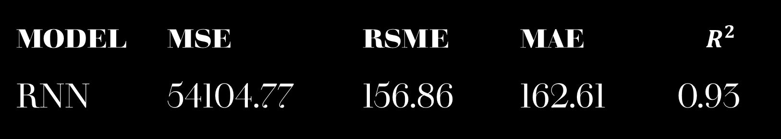
Performance Evaluation
Model | MSE | RSME | MAE | $$R^{2}$$
RNN | 54104.77 | 156.86 | 162.61 | 0.93

Slide 15
Conclusion and Recommendations
While the MSE, RSME and MAE are relatively high, we have very good R2 score. With a score of approximately 92.566% , we can interpret this to mean that 92.566% of the variance in explained by our RNN.
As data sets become more and more readily available, it may prove to be beneficial to conduct this analysis again in the future on different time series data sets and see how well the model performs.
It may also be helpful to build different models with different parameters to determine which one performs best on a given data set.

Slide 16

Conclusion
Thank you for listening. Any questions?

